Slide 1

MINUTES OF MEETING
AI-Powered Enterprise Meeting Assistant

Slide 2
What is Minutes of Meeting?
Meeting minutes are the written or recorded documentation that is used to inform what was discussed during a meeting.
Meeting minutes or notes are generally taken by a designated person.
Minutes are the live written record of a meeting.
The purpose is to record what actions have been assigned to whom, along with the achievements and the deadlines.

Slide 3
Minutes of Meeting Template
A minute of meeting normally includes the following elements
Name of the company − to the top-left of the page
Date − to the top-right of the page
Topic − after two return keys; Center-aligned
Attendees − Name and designation (2 columns of a table)
Absentees − name, roles, reasons for absenteeism (3 columns)
Agenda at hand − topic to be discussed
Issues raised − along with the names of the speakers
Suggestions − made along with the names of the speakers
Decision − the outcome of the meeting
Task List − task allotted and the respective allottee
Future Meetings − the date and topic of the next meeting

Slide 4
Project Motivation
What it is the importance of this document in professional organizations?
Written record
Bring all attendee on same page
Measuring stick
How the organizations produce this document?
During the meeting a designated person take notes
After the meeting organize all the points and present a formal document
The current technology will make the work easier
Natural Language Processing
Audio Processing
Website Development
Notes:
`

Slide 5
Project Definition
In this FYP we will automate the process of generation of Minutes of the Meeting. This project will be Research and Product based.

Slide 6
Project Stakeholders
This product will be mainly used by corporate organizations and individuals which conducts meeting and maintains the record of it.

Slide 7
Project Scope
This project will only compute Minutes with Meeting having English Language as medium of discussion.
Only the things discussed in the meeting will only be included in the process of generation of minutes of meeting.

Slide 8
Literature and Application Review

Slide 9
Literature Review
Improved Keyword and Keyphrase Extraction from Meeting Transcripts by Immanuvel Rajkumar, Sheeba & Vivekanandan, Kumuda
A Supervised Framework for Keyword Extraction From Meeting Transcripts. Audio, Speech, and Language Processing by Liu, Fei & Liu, Feifan & Liu, Yang
Rapid Keyphrase extraction from audio transcripts of video lectures by Aruna, V. & Harini, S. & Ranjitha, R. & Palanivel
Text categorization with support vector machines: Learning with many relevant features by Joachims, Thorsten
The probability ranking principle in IR by Robertson, Stephen E.
Speaker diarization with LSTM by Wang, Quan, et al.
Notes:
For More Specific Details
https://docs.google.com/document/d/1i3gv8KaVQNzHX4jMmrUE0k0M_2cBvleHbYVIyRXgCS4/edit?usp=sharing

Slide 10
Application Review
REASON8.AI
Mobile Application - Each participant needs the app on their mobile
OTTER.AI
Mobile Application - On single mobile
Import audio and video, take snap of meeting and embed it to meeting notes
VOCIEA.COM
Mobile and Web Application
Harder to Setup
Uses an AI assistant as the way to capture your meeting notes
Notes:
For More Specific Details
https://docs.google.com/documnt/d/1i3gv8KaVQNzHX4jMmrUE0k0M_2cBvleHbYVIyRXgCS4/edit?usp=sharing

Slide 11
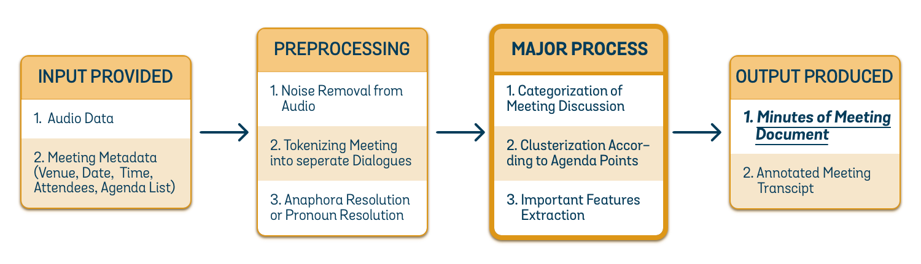
Architecture Block Diagram (Generic)

Slide 12
Input Data for Task
Meeting’s Audio Recording
It will help us to get the transcript of meeting
Meeting’s Metadata
Organization name, Meeting’s date, time, venue, attendees, and Meeting’s agenda list
It will help us to get compute the minutes accurately
Also, it will help us to improve the transcript generated from audio data
The given list of attendees will help to resolve the pronouns in the generated transcript

Slide 13
Major Processes Involved (1 / 2)
Speaker Diarization
Partition the audio stream into dialogues of different attendees
Used Amazon Transcribe
Text to Speech
Convert Meeting’s audio data to Meeting’s transcript
Used Amazon Transcribe
Anaphora resolution
Resolving what a pronoun, or a noun phrase refers to
Used Stanford CoreNLP Coref Annotator
Clustering of Meetings Discussion according to Agenda
All discussion regarding an agenda will be gathered
Developed Own Solution

Slide 14
Major Processes Involved (2 / 2)
Categorization of Meetings Points
Discussion, Task Assigned, Recommendations and Interrogative
Developed Own Solution
Pairing Questions and their Answers
Developed Own Solution
Extracting Important Features from Discussion
Developed Own Solution
Computing Sentence Importance Score
Developed Own Solution
Drafting Minutes of Meeting
Combining all of the Previous Work

Slide 15
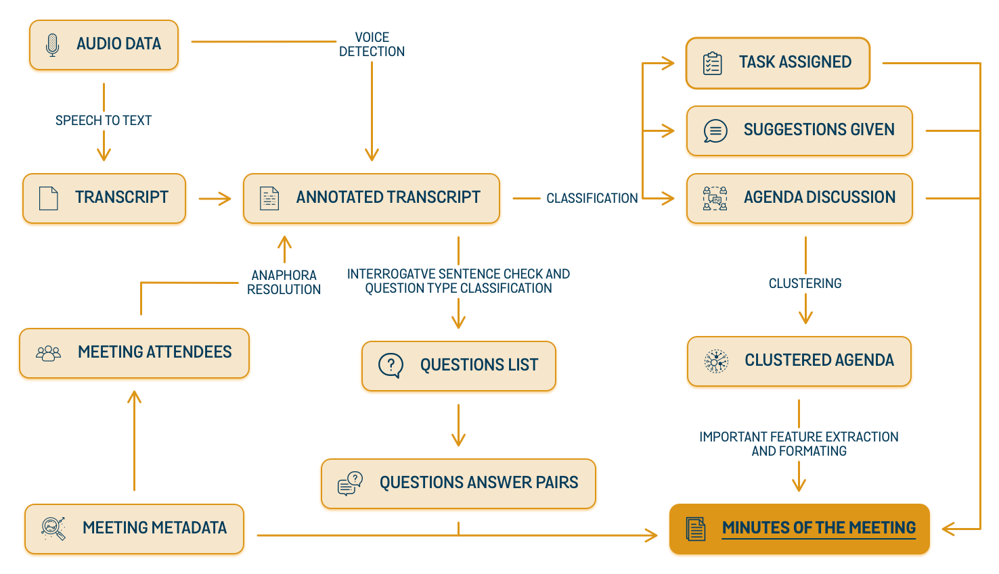
Architecture Block Diagram (Detailed)

Slide 16
Clustering of Meeting Discussion According to Agenda List

Slide 17
Tried Combinations
Clustering Algorithms
K-Means
Agglomerative
Gaussian Mixture
Birch
Tokenizers
Tf-idf Vectorizer
Count Vectorizer
Document Embeddings
Universal Sentence Encoder (USE)
Preprocessing
Removal of Stopwords or not
Lemmatization
Stemming
Bag of Words
Notes:
Clustering Algorithms:
https://scikit-learn.org/stable/modules/generated/sklearn.cluster.KMeans.html
https://scikit-learn.org/stable/modules/generated/sklearn.cluster.AgglomerativeClustering.html
https://scikit-learn.org/stable/modules/generated/sklearn.mixture.GaussianMixture.html
https://scikit-learn.org/stable/modules/generated/sklearn.cluster.Birch.html
Universal Sentence Encoder
https://tfhub.dev/google/universal-sentence-encoder/4

Slide 18
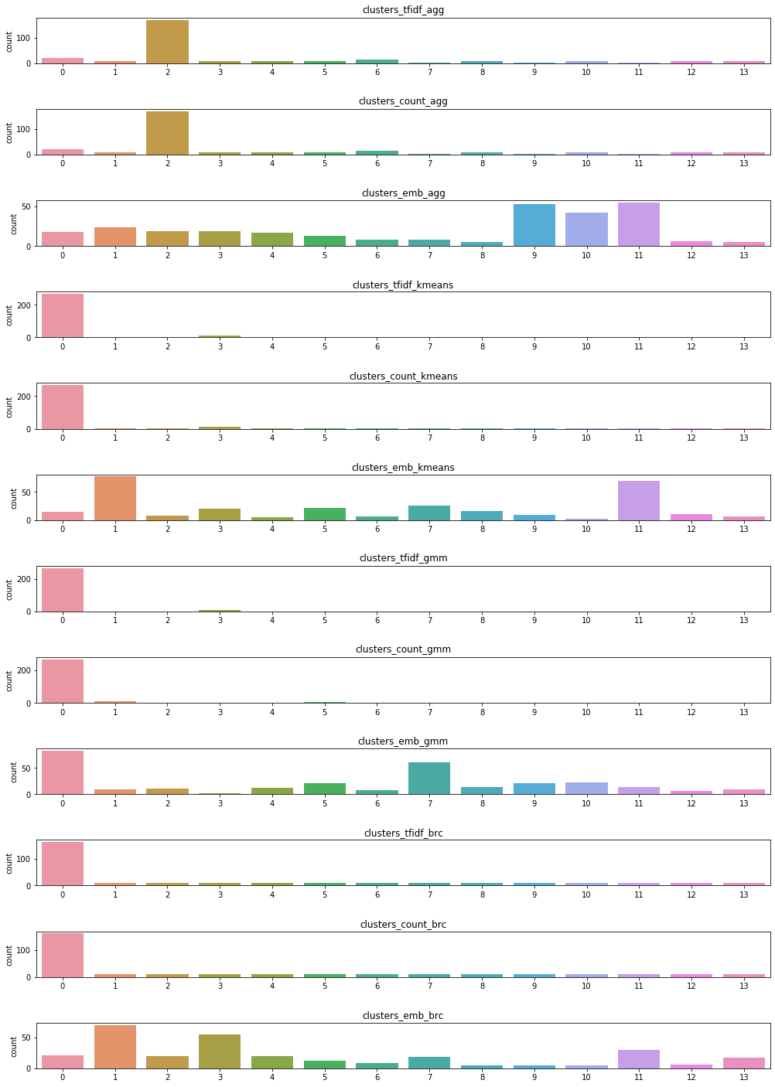
Sentence Distribution

Slide 19
Purity Score for USE
Technique Used
Vector Embeddings for each sentence using USE
Selected top features using Principal Component Analysis (PCA)
Cluster the sentence using Agglomerative Algorithm
Find topics keywords for each cluster using Latent Dirichlet Allocation Model (LDA)
Train the Stochastic Gradient Descent Classifier on sentence and keywords
Computed Cross Validation Mean Score for the trained classifier
Clustering Algorithm | Purity Score
K-Means | 90.223
Agglomerative | 91.014
Gaussian Mixture | 88.682
Birch | 89.383
Notes:
https://tfhub.dev/google/universal-sentence-encoder/4
https://scikit-learn.org/stable/modules/generated/sklearn.decomposition.PCA.html
https://scikit-learn.org/stable/modules/generated/sklearn.cluster.AgglomerativeClustering.html
https://scikit-learn.org/0.16/modules/generated/sklearn.lda.LDA.html
https://scikit-learn.org/stable/modules/generated/sklearn.linear_model.SGDClassifier.html

Slide 20
Issues Faced
We thought that K-Means will work better
As agglomerative is been selected so we have to do Topic Modelling too
Probabilistic Ranking Principle was expected solution but was not upto the mark
What criteria be for marking a word relevant
May be the data is not of that quality
Agenda list provided is not the real agenda
Use of too many abbreviations
Notes:
Probabilistic Ranking Principle - PRP is described in detail in Literature Review above

Slide 21
Classification of Sentences
Suggestions
Task Assigned
Normal
Interrogative Sentence

Slide 22
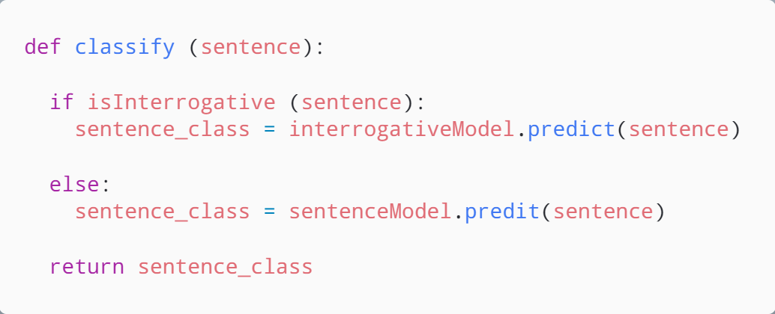
Classification Algorithm
Notes:
isInterrogative used Stanford CoreNLP Sentence parser.
S - simple declarative clause, i.e. one that is not introduced by a (possible empty) subordinating conjunction or a wh-word and that does not exhibit subject-verb inversion
SBAR - Clause introduced by a (possibly empty) subordinating conjunction
SBARQ - Direct question introduced by a wh-word or a wh-phrase. Indirect questions and relative clauses should be bracketed as SBAR, not SBARQ
SINV - Inverted declarative sentence, i.e. one in which the subject follows the tensed verb or modal
SQ - Inverted yes/no question, or main clause of a wh-question, following the wh-phrase in SBARQ
http://www.surdeanu.info/mihai/teaching/ista555-fall13/readings/PennTreebankConstituents.html

Slide 23
Interrogative Sentence Classification
Types of Interrogative Sentences
Affirmation (YES or NO)
What
When (Time)
Who (Person)
Unknown
Trained Mode
Support Vector Machine (SVM) Classifier

Slide 24
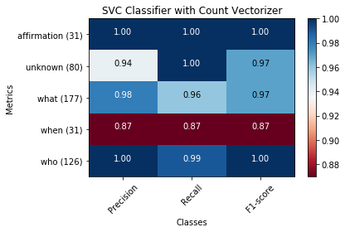
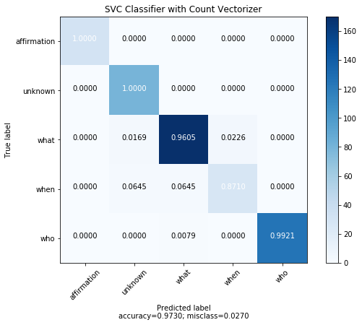
Support Vector Machine Classifier

Slide 25
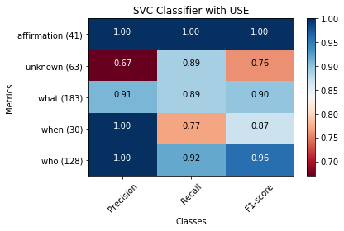
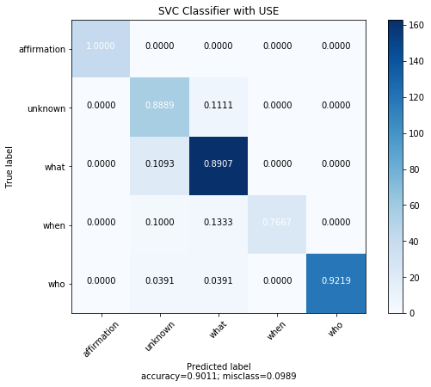
Support Vector Machine Classifier
Using Universal Sentence Encoder

Slide 26
Tried Combinations
Normal Suggestions and Task Assigned Classification
Statistical Models
Logistic Regression Classifier
Support Vector Machine (SVM) Classifier
Support Vector Machine (SVM) Classifier with Universal Sentence Encoder
Gradient Boosting Decision Tree
LightGBM Classifier
eXtreme Gradient Boosting Classifier
Deep Learning Model
Hybrid Neural Network Classifier
Hybrid Neural Network Classifier with Universal Sentence Encoder

Slide 27
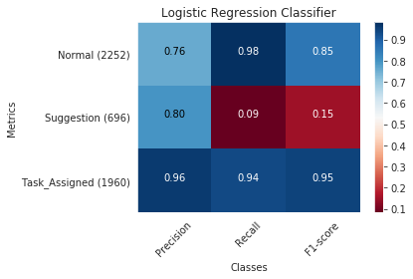
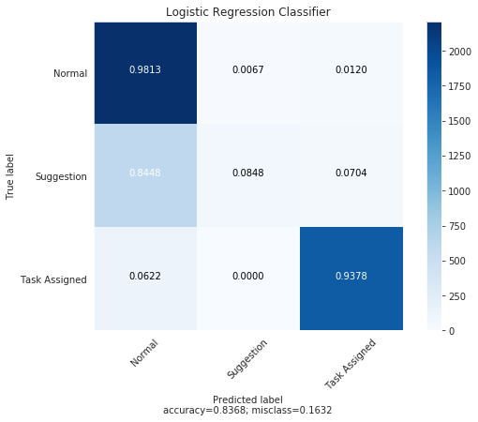
Logistic Regression Classifier

Slide 28
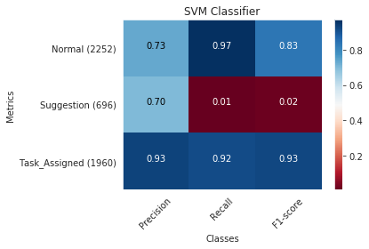

Support Vector Machine Classifier

Slide 29
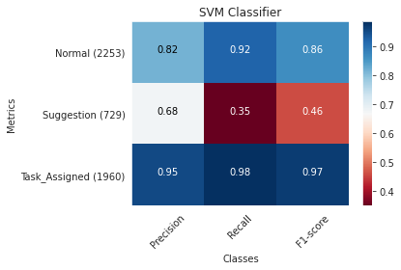
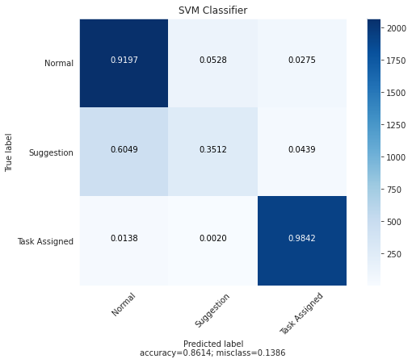
Support Vector Machine Classifier
Using Universal Sentence Encoder

Slide 30
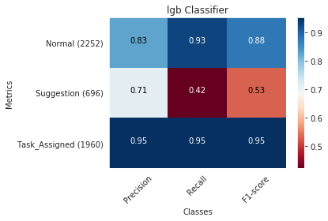
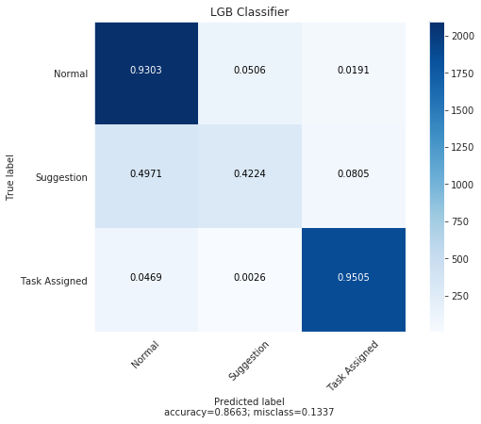
LightGBM Classifier

Slide 31
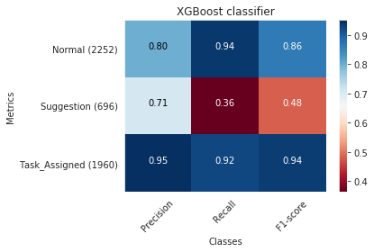

XGBoosting Classifier

Slide 32
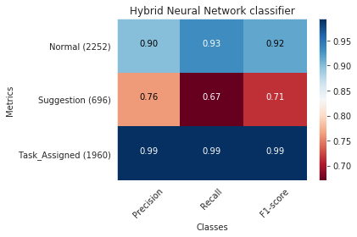

Hybrid Neural Network Classifier

Slide 33
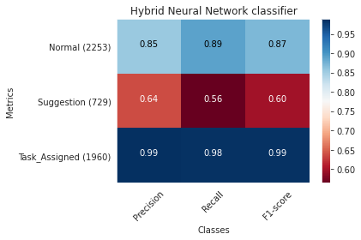
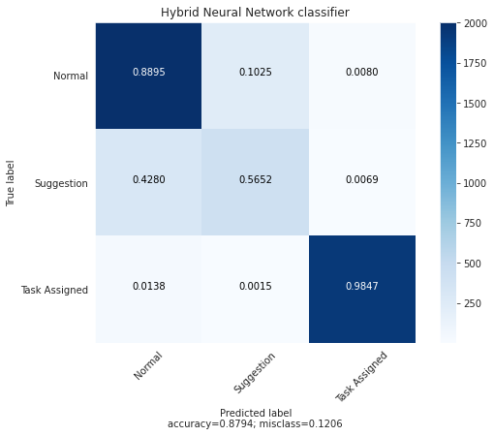
Hybrid Neural Network Classifier
Using Universal Sentence Encoder

Slide 34
Issues Faced
Not a data set to so that we can get a Ground Truth
The data set is combined by different Email Sources
Model is trained on written language but its used for spoken language
Different kind of language structure
Model is not up to the mark

Slide 35
Important Feature Extractions
Sentences with not words
Sentences with statics
Sentences with date
Sentiment of a sentence and its score

Slide 36
Sentences with not words
Sentences containing the word not or it synonyms
Synonyms of NOT : {'no', 'not', 'nay', 'nix', 'never'}
Used regex for matching the string i.e. '^(no|not|nay|nix|never)$
Sentences containing the word with negative prefixes
Negative Prefixes: {'in', 'un', 'non', 'de', 'dis', 'a', 'anti', 'im', 'il', 'ir'}
If the word starts with any of the prefix then check if the remaining word is valid english word (in english dictionary)
Used regex to identify the valid prefix '^(in|un|non|de|dis|anti|a|im|il|ir)\w+$'
Used NLTK.corpus.words library to validate the word

Slide 37
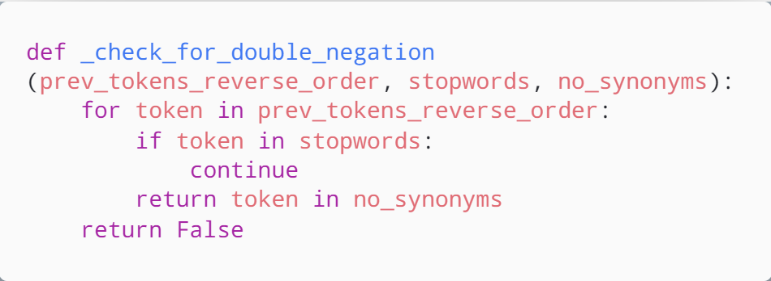
What about Double Negation

Slide 38
Sentences with statistical value
Sentences containing value in figures
Used regex for matching the statistical figures i.e. '[+-]?[0-9][0-9]*'
Sentences containing the value in words
Can use trie tree to search the pattern
Can use Context Free Grammar to create a parser
Or simple a regex will solve our problem '^(zero|one|two|three|four|five|six|seven|eight|nine|ten|eleven|twelve|thirteen|fourteen|fifteen|sixteen|seventeen|eighteen|nineteen|twenty|thirty|forty|fifty|sixty|seventy|eighty|ninety|hundred|thousand|million|billion|trillion)$

Slide 39
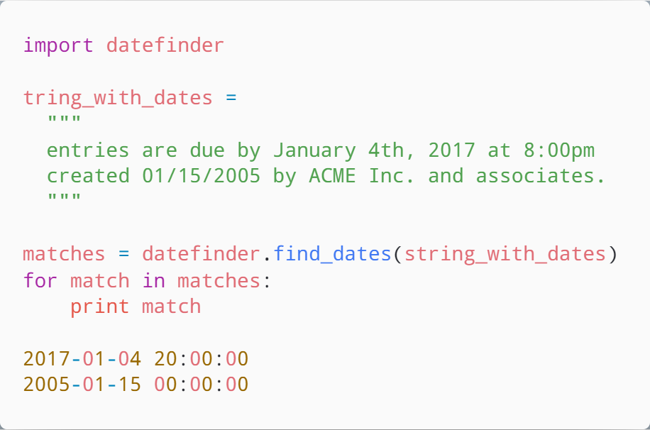
Sentences with Dates
Used python library “datefinder”
Uses regex matching internally to find all possible date combinations

Slide 40
Sentiment of a sentence and its score
Types of Sentences
Positive
Negative
Neutral
Used STANFORD CORENLP Sentiment Annotator
"Very negative" = 0
"Negative" = 1
"Neutral" = 2
"Positive" = 3
"Very positive" = 4

Slide 41
Text Summarization
Extractive Summarization

Slide 42
Types of Text Summarization
Extractive Summarization
Rely on extracting several parts, such as phrases and sentences, from a piece of text
stack them together to create a summary
Identifying the right sentences for summarization is of utmost importance in an extractive method
Sentences containing the value in words
Generate an entirely new summary
Some parts of this summary may not even appear in the original text.

Slide 43
TextRank Algorithm
TextRank is an extractive and unsupervised text summarization technique.
The working of TextRank Algorithm is as following:
Concatenate all the text contained in the articles
Split the text into individual sentences
Find vector representation (word embeddings) for each and every sentence
Similarities between sentence vectors are then calculated and stored in a matrix
The similarity matrix is then converted into a graph, with sentences as vertices and similarity scores as edges, for sentence rank calculation
Finally, a certain number of top-ranked sentences form the final summary

Slide 44
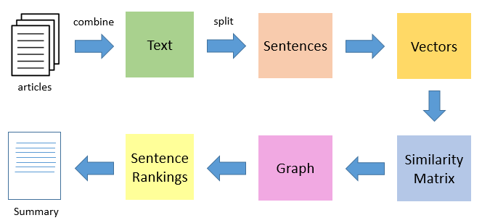
TextRank Algorithm

Slide 45
Working Example

Slide 46

Sample Video
Notes:
https://www.youtube.com/watch?v=Ecd9OhMf73k

Slide 47
Result of Speech Transcriber
sentence | speaker | dialogue_id
Shall we start with an update from everyone? | spk_1 | 6
Can we try and keep this to 20 minutes, though? | spk_1 | 7
So we have time for the main | spk_1 | 7
item afterwards. | spk_5 | 8
Maria? | spk_1 | 11
What's happening in the training department this week? | spk_1 | 12
So far, so good. | spk_3 | 13
We have to external trainers in this week. | spk_3 | 13

Slide 48
Pronoun Resolution
sentence | speaker | dialogue_id
Shall we start with an update from everyone? | spk_1 | 6
Can we try and keep this to 20 minutes, though? | spk_1 | 7
So we have time for the main | spk_1 | 7
item afterwards. | spk_5 | 8
Maria? | spk_1 | 11
What's happening in the training department this week? | spk_1 | 12
So far, so good. | spk_3 | 13
We have to external trainers in this week. | spk_3 | 13

Slide 49
Agenda Clustering
sentence | Cluster Index
Shall we start with an update from everyone? | 1
Can we try and keep this to 20 minutes, though? | 2
So we have time for the main | 1
item afterwards. | 2
Maria? | 1
What's happening in the training department this week? | 1
So far, so good. | 3
We have to external trainers in this week. | 5

Slide 50
Sentence Type Classification
sentence | type
Shall we start with an update from everyone? | INTERROGATIVE
Can we try and keep this to 20 minutes, though? | INTERROGATIVE
So we have time for the main | NORMAL
item afterwards. | NORMAL
Maria? | INTERROGATIVE
What's happening in the training department this week? | INTERROGATIVE
So far, so good. | NORMAL
It's not really their decision to go or not. | SUGGESTION

Slide 51
IMPORTANT FEATURE EXTRACTION
sentence | Not-word found | figure found | Date found | Sentiment type | Sentiment score
Shall we start with an update from everyone? | FALSE | FALSE | FALSE | Neutral | 2
Can we try and keep this to 20 minutes, though? | FALSE | FALSE | TRUE | Negative | 1
So we have time for the main | FALSE | FALSE | FALSE | Neutral | 2
item afterwards. | FALSE | FALSE | FALSE | Neutral | 2
be careful with that one, maria. | FALSE | TRUE | FALSE | Positive | 3
So far, so good. | FALSE | FALSE | FALSE | Positive | 3
It's not really their decision to go or not. | TRUE | FALSE | FALSE | Negative | 1

Slide 52








TECHNOLOGIES USED
Notes:
Stanford Core NLP
Use the API’s in the following Natural Language Processing Tasks:
Pronoun Resolution
Interrogative Sentence Check
Sentiment Analysis
Tensor Flow
Use pretend model Universal Sentence Encoder in
Sentence Classification
Agenda Wise Clustering
Use Neural Network Models in
Sentence Classification
Python
All the backend Natural Language Processing are written in PYTHON
Amazon Web Service (AWS)
Audio Transcribe is Used for
Speech to Text
Speech Diarization
Node JS
Flask
MongoDB
Angular

Slide 53
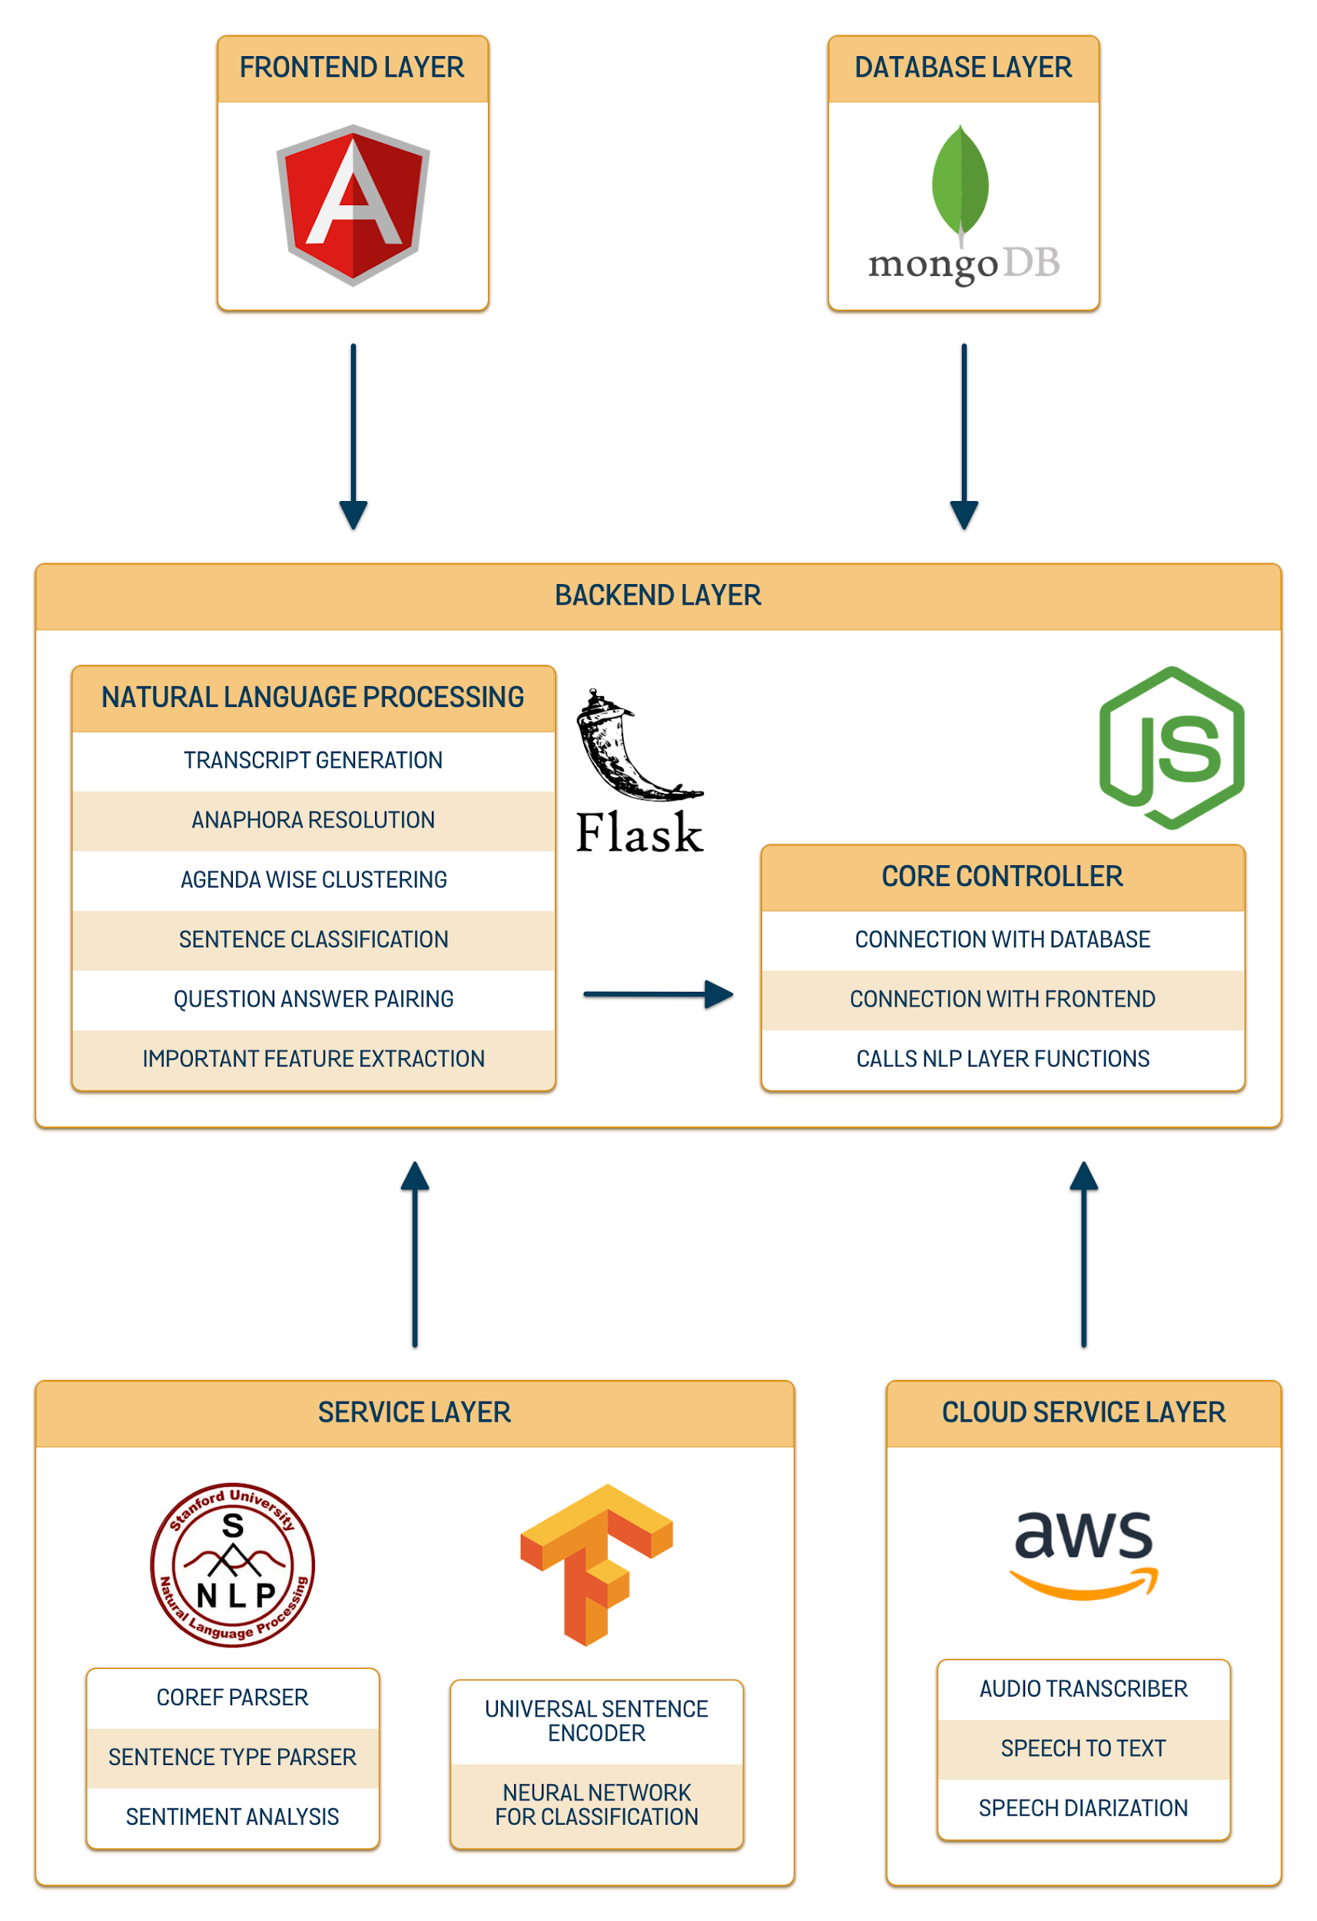

Slide 54






Dr. MUHAMMAD RAFI
Mehdi Raza Rajani
(FYP SUPERVISOR)
Email Address: muhammad.rafi@nu.edu.pk
LinkedIn: muhammad-rafi-34339219
(GROUP LEADER)
Email Address: k163904@nu.edu.pk
GitHub: mehdirazarajani
LinkedIn: mehdirazarajani572
TEAM MEMBERS
Hussain Yousuf
Hussain Yousuf
Shehryar Naeem
Email Address: k163805@nu.edu.pk
GitHub: HussainYousuf
LinkedIn: hussain-yousuf-93c3757
Email Address: k163950@nu.edu.pk
GitHub: shehryarnaeem
LinkedIn: shehryar-naeem-291a3016b

Slide 55
Conclusion
Meetings are essential for sharing information
Advance technology will automate the meeting’s minutes generation process
AI-powered voice note application for automated note-taking and summary preparation for in-person meetings
Enterprise Meeting Assistant - E.M.A will join your session and record the meeting, observe the speaker, and extract essential pointers from the attached documents
Some metadata will be given as input to the system
Clumps the meeting points according to the agenda of the meeting
Assign tasks to attendees

Slide 56
MINUTES OF MEETING
The End
THANK YOU

